Slide 1
Update: Integration of single cell transcriptomic atlases of the adult human and mouse ventral midbrain

Slide 2
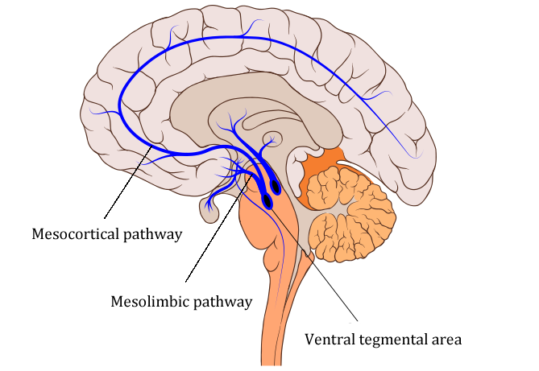
Ventral Midbrain
Role in:
Cognition
Reward system
Regulation of emotion, motivation and behavior
Problem: High heterogenity

Slide 3
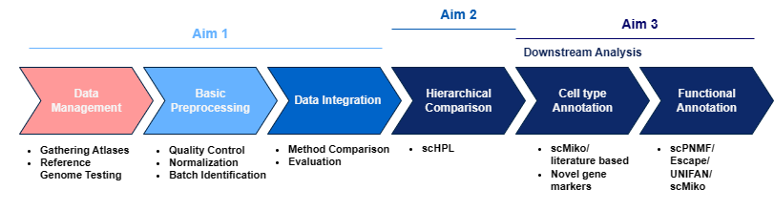
Recap: Aim
Integrate multiple atlases into one unified human (ventral) midbrain atlas
Determine relations between identified cell types by the authors of the atlases
Determine (new) cell types, functions and potential marker genes

Slide 4
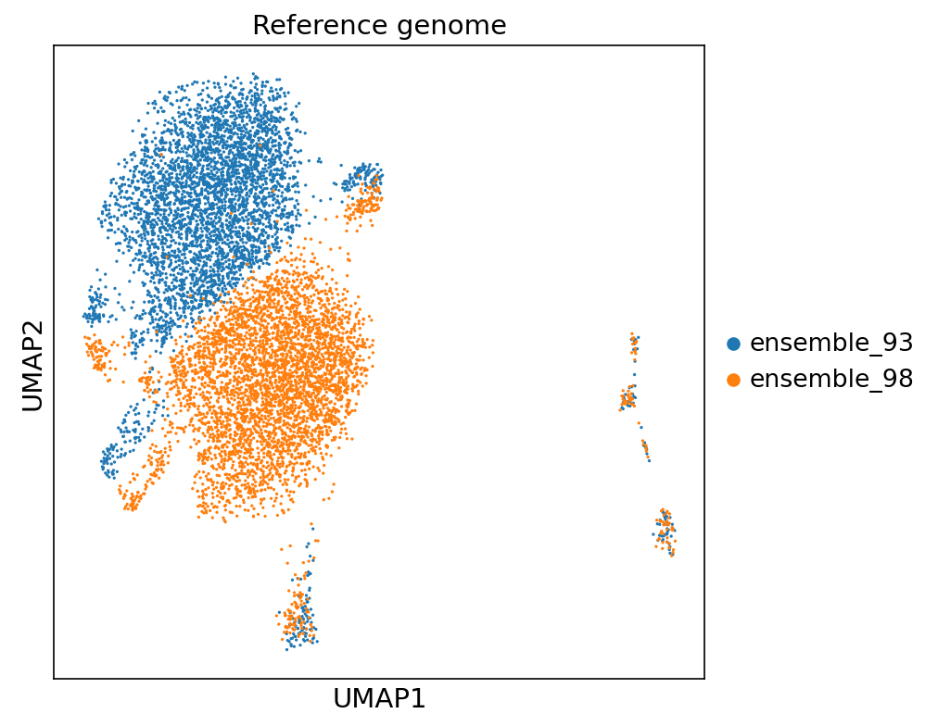
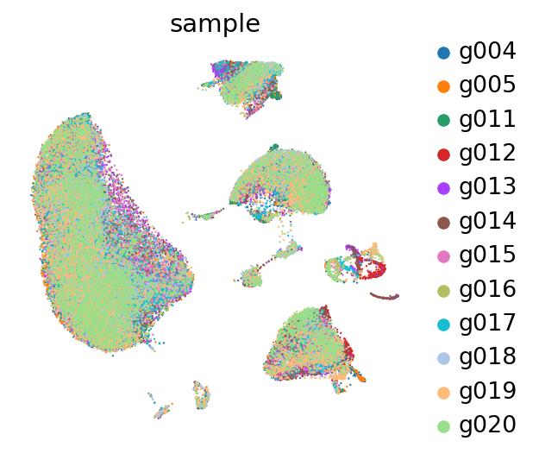
Previously: Tests, processing data and between donor integration

Slide 5
Human data
snRNA atlas | Pre filtering | Post (lenient) filtering
Kamath et. al. (2022) | Requested (15,684 DA cells) | /
Siletti et. al. (2022) | 296,714 midbrain cells | 287,523 midbrain cells
Wang et. al. (2022) | 152,899 SN cells | 43,477 SN cells
Agarwal et. al. (2021) | 13,680 SN cells | 9,214 SN cells
Smajic et. al. (2021) | 30,301 SN cells | 29,495 SN cells
Welch et. al. (2019) | 172,137 SN cells | 67,467 SN cells
Van Regteren Altena et. al. | 89,976 VTA cells | 85,044 VTA cells
Total | 755,707 cells | 522,220 cells

Slide 6
Recommended integration methods
Tran et. al. (2020): Harmony, LIGER, and Seurat 3 (13 methods, no scVI/scANVI)
Luecken et. al. (2022): scANVI, Scanorama, scVI, scGEN (16 methods)
Steuernagel et. al. (2022): scVI, Harmony, Scanorama (5 methods, no scANVI)
Harmony and Seurat: performs well on simpler datasets
Scanorama and scVI: better on complex datasets
scGen and scANVI: perform well on all tasks, but require labels...
scVI and scANVI: great memory scalability and do not increase runtime (due to heuristic)
Our datasets
Different regions e.g. VTA specific atlas and SN specific atlases
522,220 cells
Benchmark: Harmony, scVI, Scanorama, scANVI?
Unlabeled cells

Slide 7
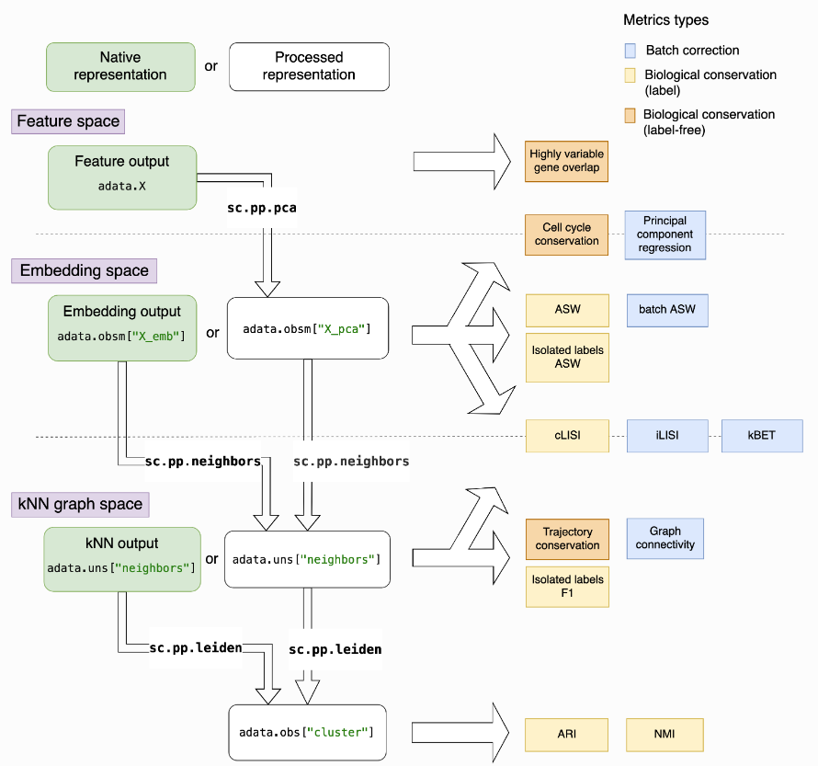
Benchmarking - scib

Slide 8
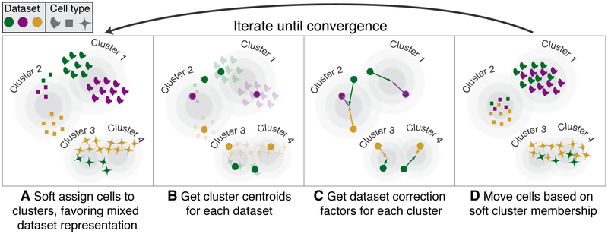
Integration pipeline - Harmony
Concatenate datasets
Take highly variable genes (2000-6000)
Computes PCA coordinates
Harmony integration
Calculate neighborhood graph
Embed the neighborhood graph using UMAP
Korsunsky et. al. (2019). Fast, sensitive and accurate integration of single-cell data with Harmony.

Slide 9
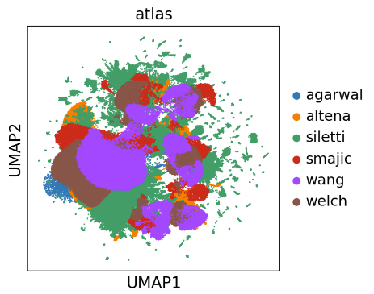
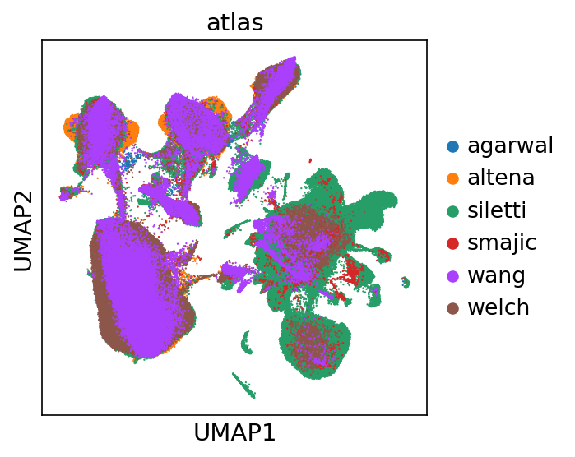
Integration results - Harmony

Slide 10
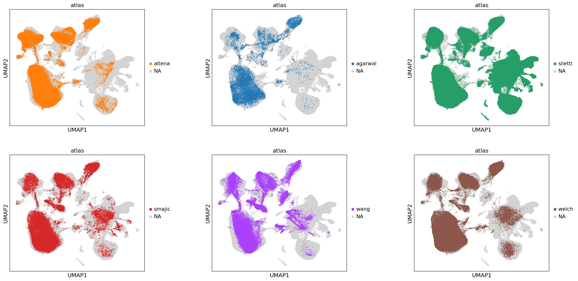
Integration results - Harmony

Slide 11
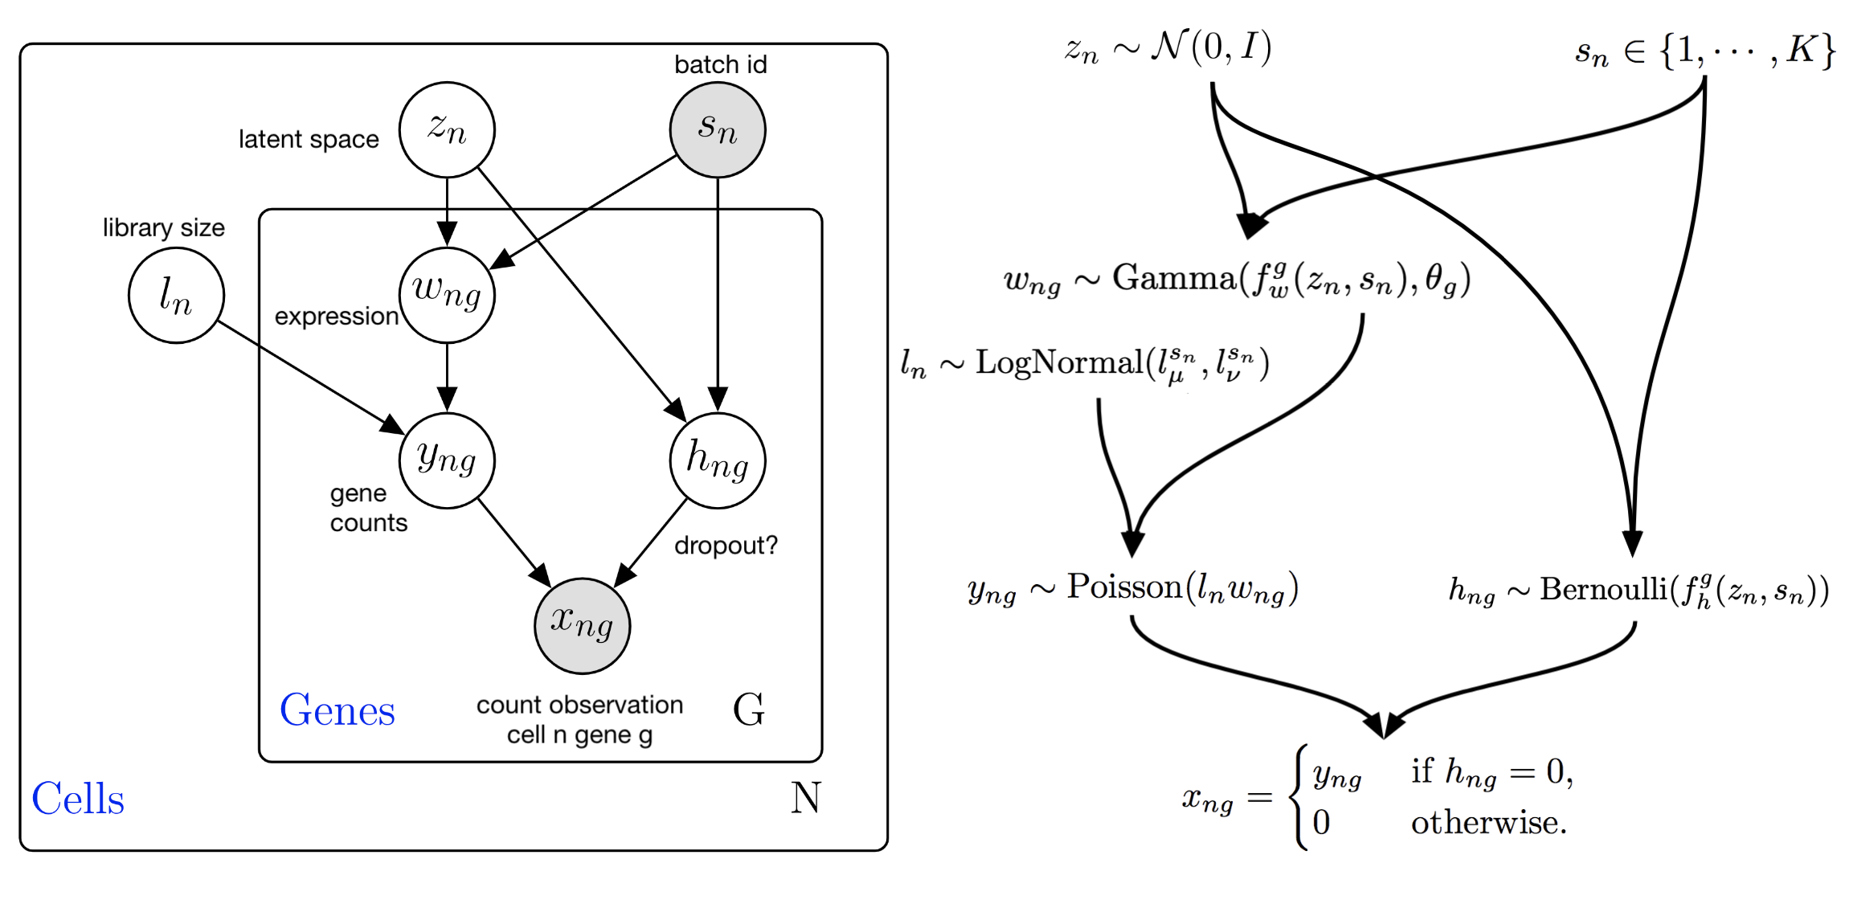
Integration pipeline - scVI
Concatenate datasets
Take highly variable genes (2000-6000)
Train neural network model (VAE) to learn latent space representation of cells
Models batch effect with given labels
Use model to project cells in latent space while correcting for batch effects
Calculate neighborhood graph
Embed the neighborhood graph using UMAP
Lopez et. al. (2018). Deep generative modeling for single-cell transcriptomics.

Slide 12
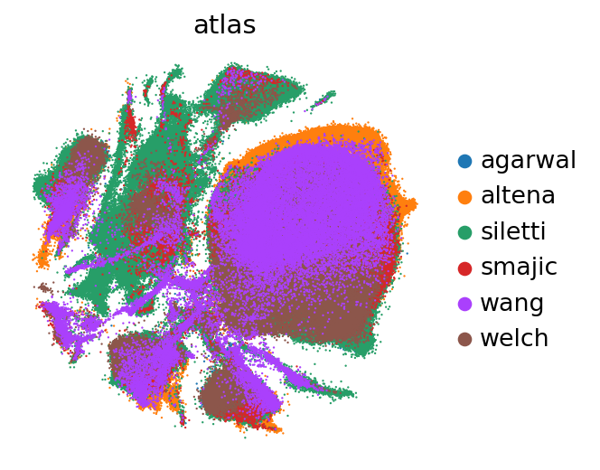
Integration results - scVI

Slide 13
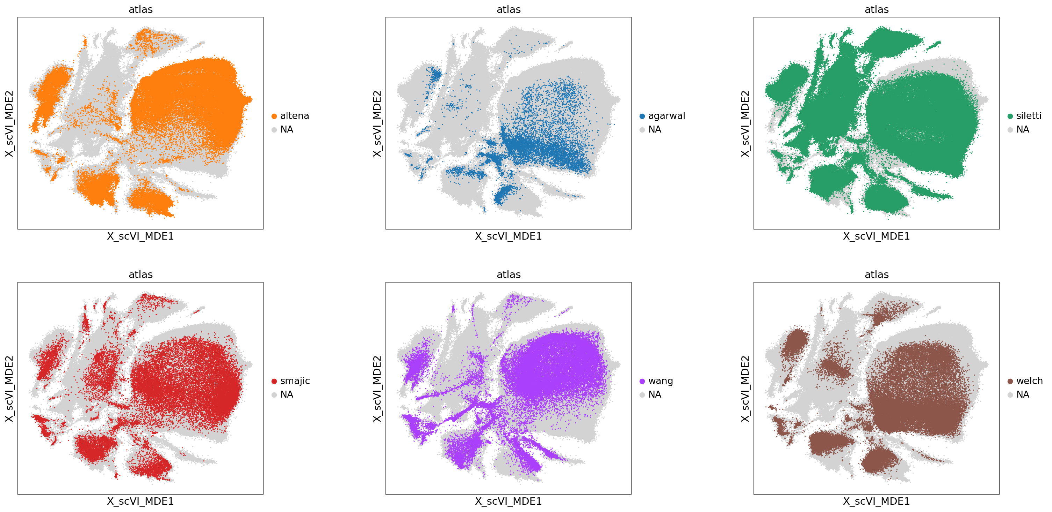
Integration results- scVI

Slide 14
Acknowledgements
Basak Lab
Onur Basak
Tiziana Hey
Abdool Al-Khaledi
Cecile Herbermann
Hol Lab
Anna van Regteren Altena
Others
Kimberly Siletti

Slide 15
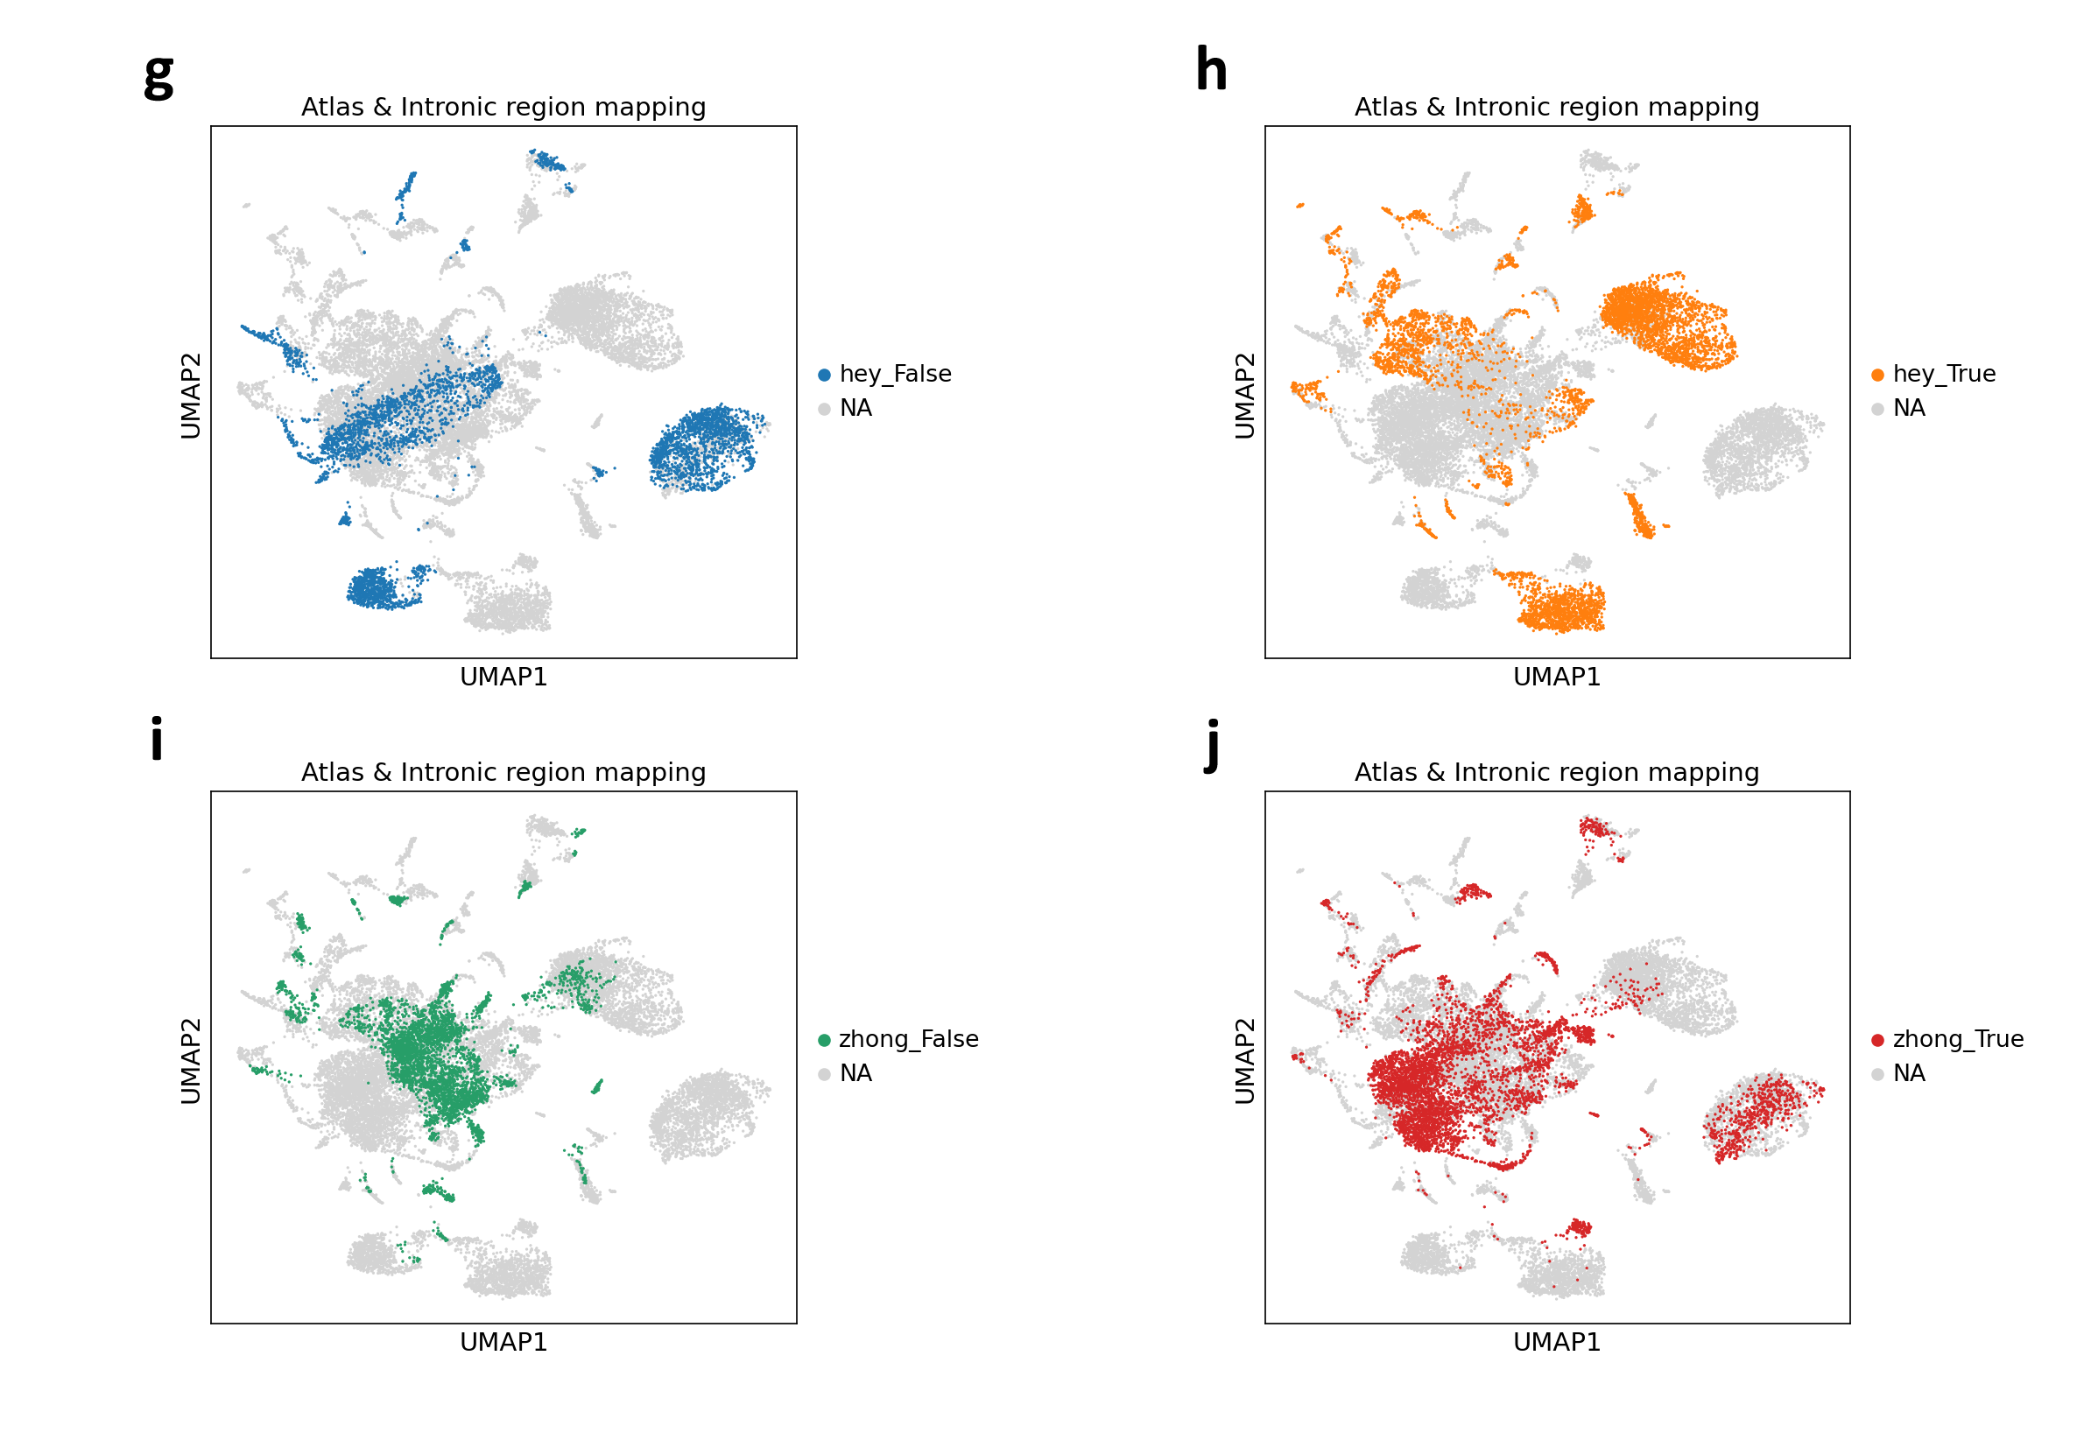
More tests: intronic mapping regress and highly-variable genes

Slide 16
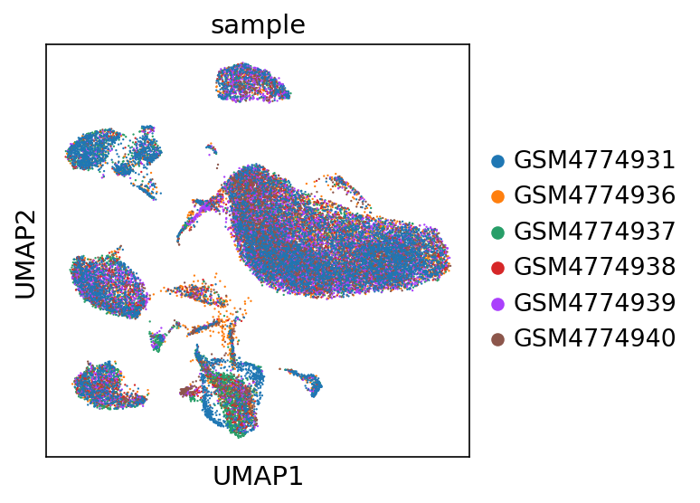
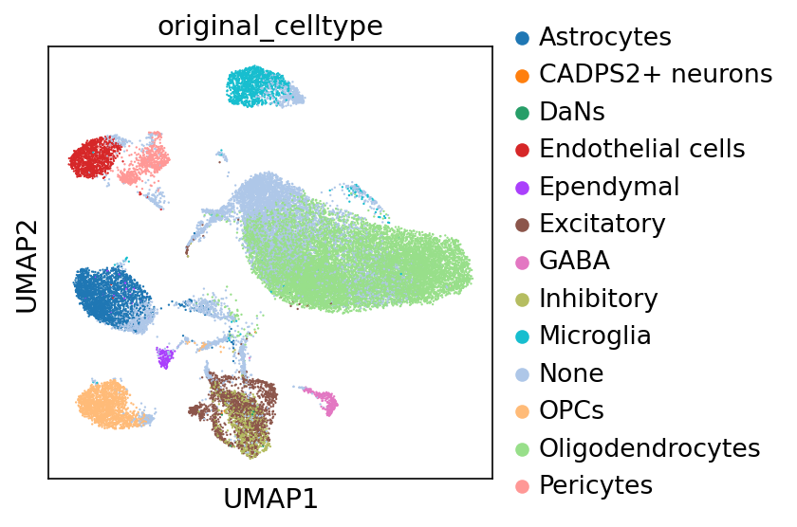
Smajic atlas

Slide 17
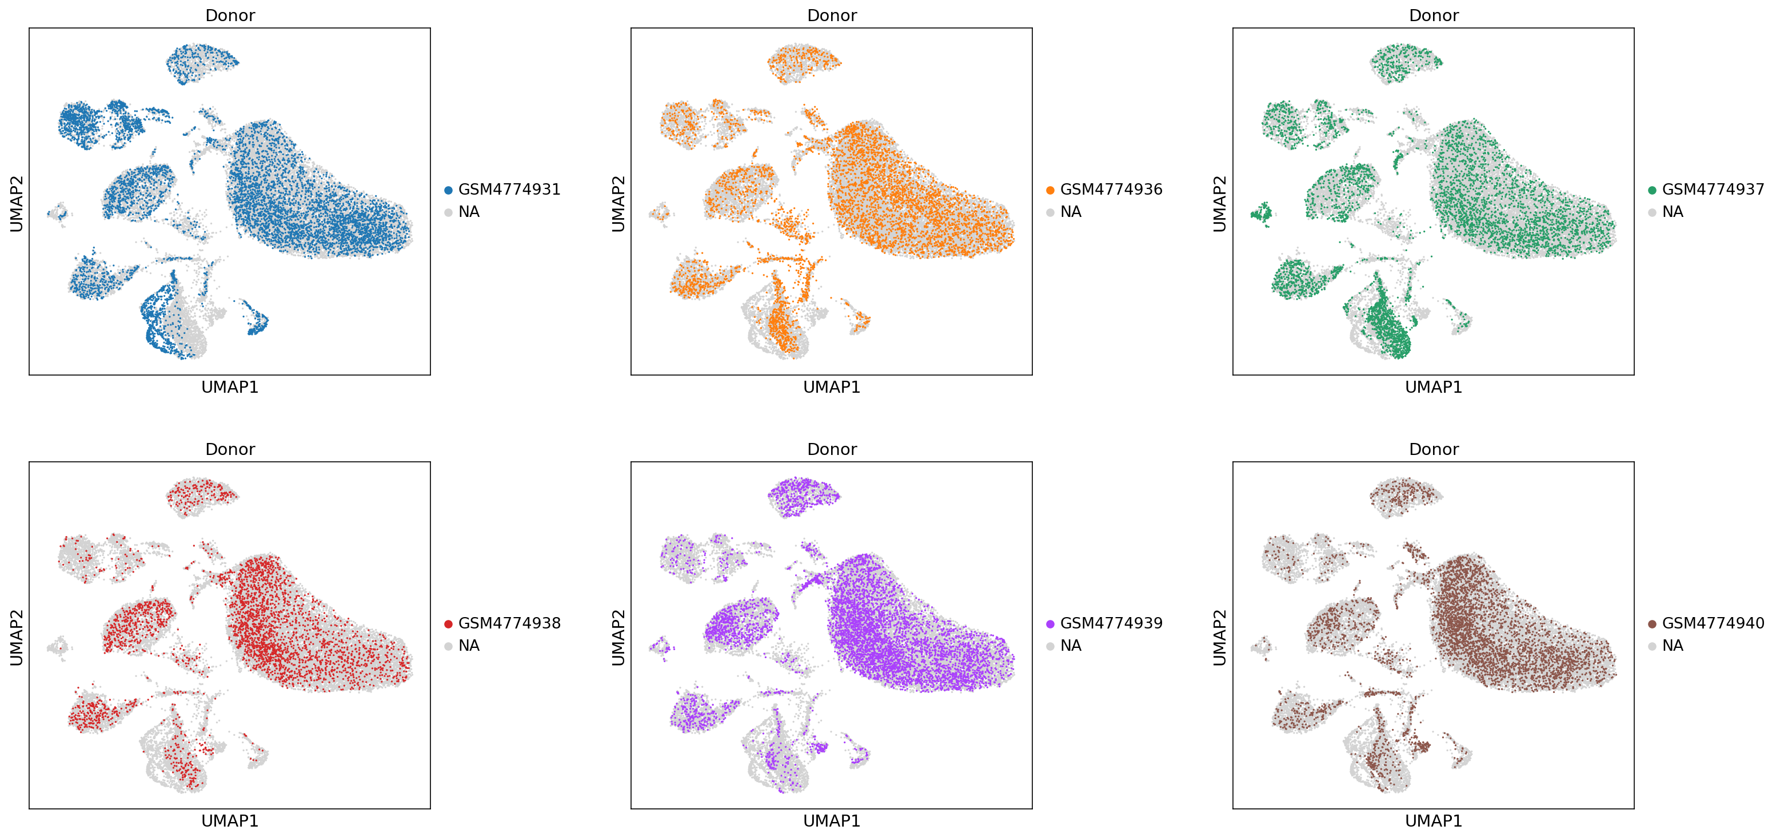
Smajic samples

Slide 18
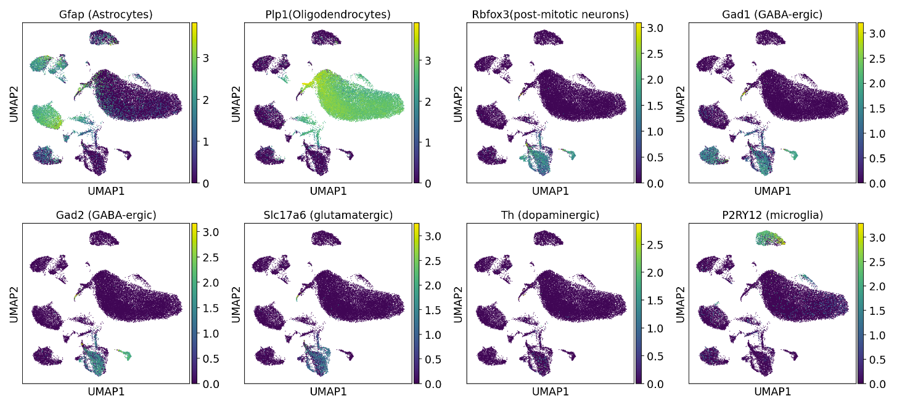
Smajic markers

Slide 19
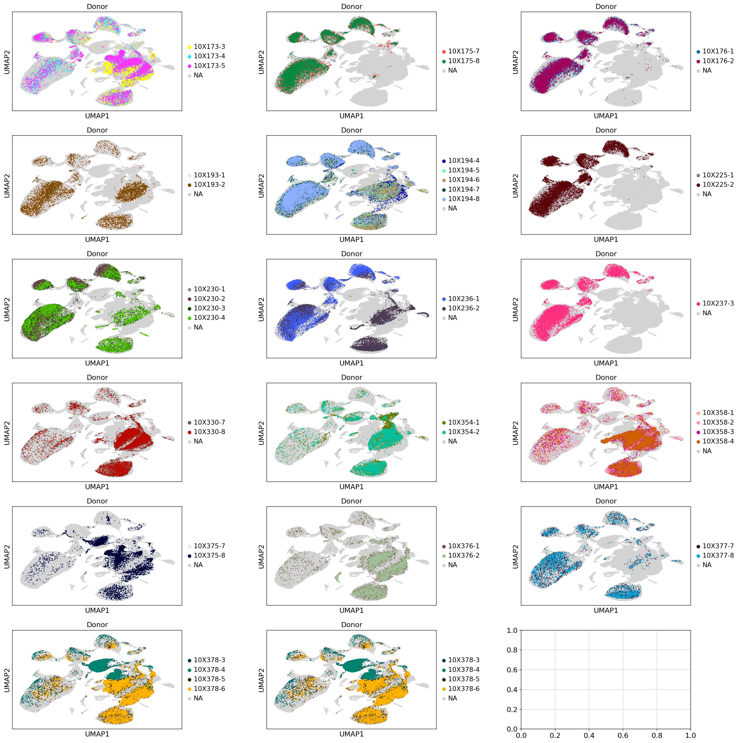
Siletti samples

Slide 20
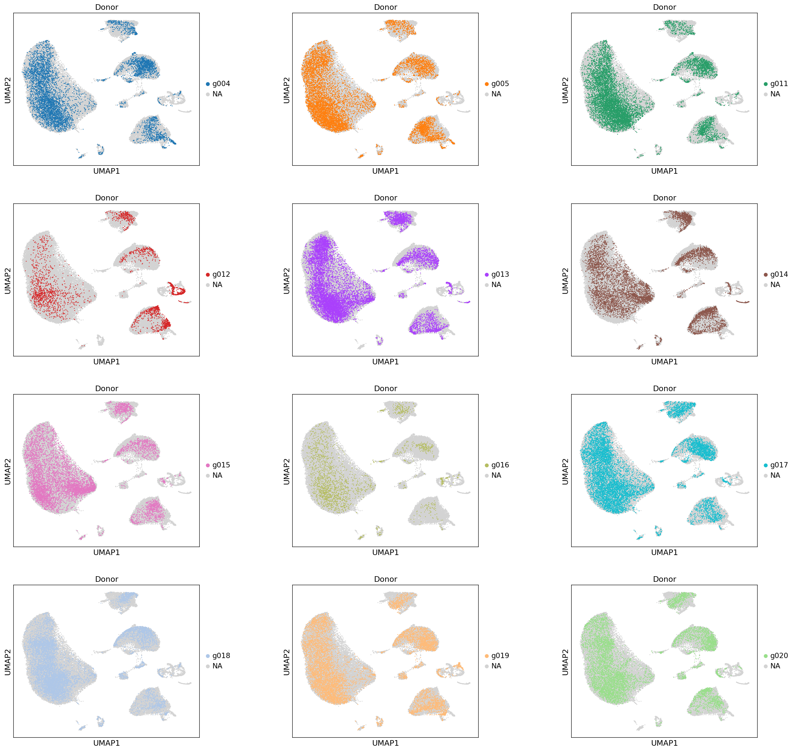
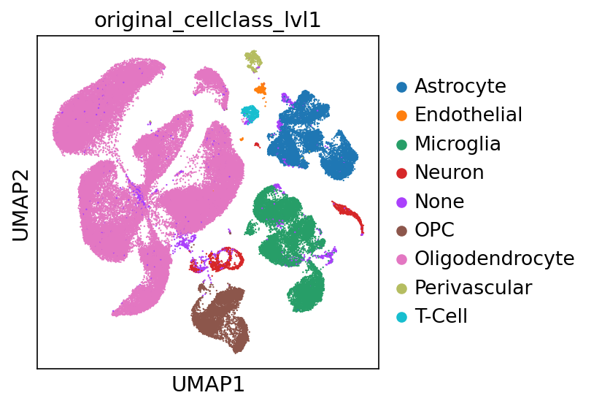
Altena samples

